Slide 1

Medical Murder is the #1 Cause of Death in the U.S. – By Design (People Are Too Expensive – Satan’s Big Lie)
What? The Culture of Death

Slide 2

We’ve been programmed to believe lies – from all sides and angles

Slide 3
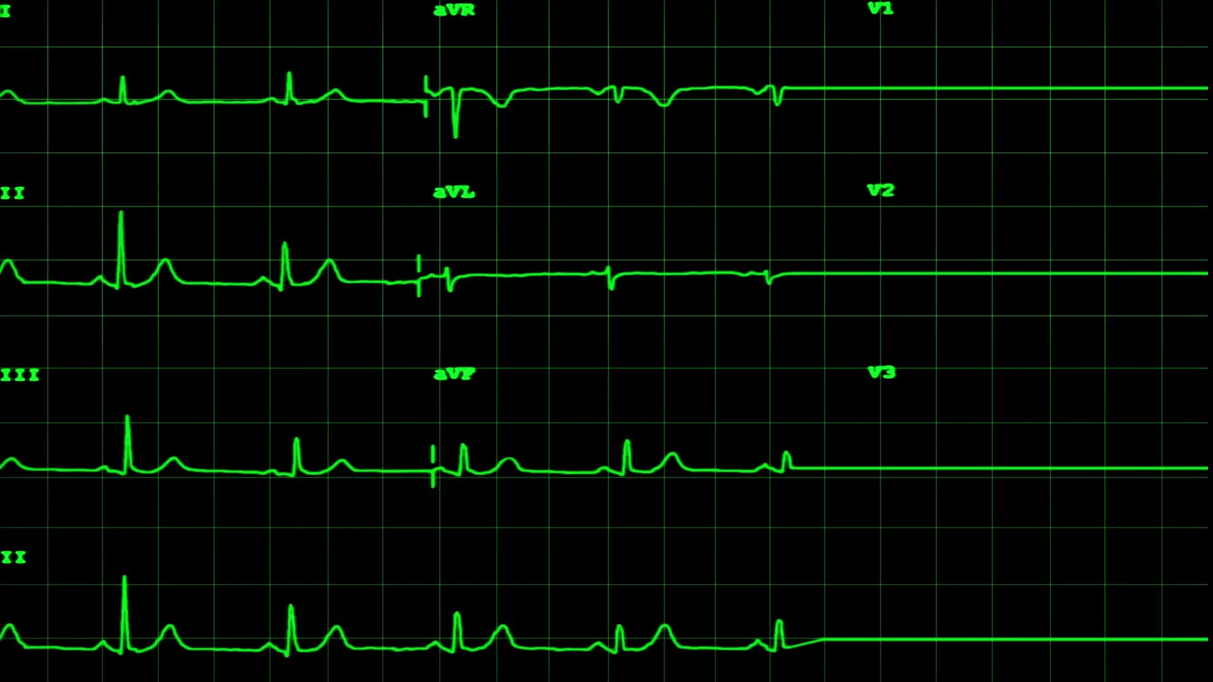
Facts:
Historical facts – pre-COVID
Annual deaths: 700K heart disease; 600K cancer; 400K medical “malpractice” (3rd leading cause of death)
https://www.statnews.com/2021/08/04/medical-errors-accidents-ongoing-preventable-health-threat/#:~:text=Injury%20or%20illness%20caused%20by,under%20wraps%20%E2%80%94%20and%20they%20are
Current facts – COVID Era and Post COVID
All cause mortality increase of 24% in vaccinated
https://www.israelnationalnews.com/news/317091
All cause mortality cumulative increase since January 2020 – weekly graph
https://ourworldindata.org/grapher/cumulative-excess-mortality-p-scores-projected-baseline?tab=chart&facet=none&country=~USA

Slide 4


Eugenics

Slide 5



What is Eugenics?
Eugenics: Excluding people and groups judged to be inferior or promoting those judged to be superior. “Survival of the fittest” has been proactively practiced since ancient times.
In one of Plato’s (died 348 BC) best-known literary works, The Republic, he wrote about creating a superior society by procreating high-class people together and discouraging coupling between the lower classes. He also suggested a variety of mating rules to help create an optimal society.

Slide 6

Current Roots
“The Rockefeller Foundation helped fund the German eugenics program and even funded the program that Josef Mengele worked in before he went to Auschwitz.”
Hitler proudly told his comrades just how closely he followed the progress of the American eugenics movement. "I have studied with great interest," he told a fellow Nazi, "the laws of several American states concerning prevention of reproduction by people whose progeny would, in all probability, be of no value or be injurious to the racial stock."

Slide 7
Conclusion: Eugenics ideas are part of our sin nature.

Slide 8

Operation Paperclip

Slide 9
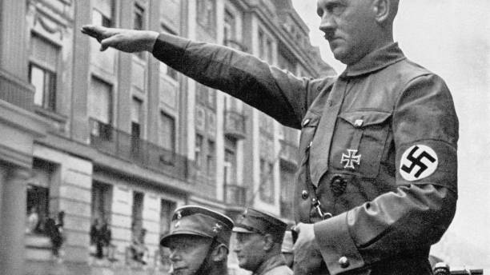
Narrative: Eugenics is publicly renounced by U.S. when Adolf Hitler adopted this philosophy
What is the truth?
https://www.youtube.com/watch?v=HHs5M3pyd3Q

Slide 10
Conclusion: The U.S. continues to be the eugenics leader of today.

Slide 11

Banality of Evil

Slide 12

Introduction
Where did the idea originate? https://www.youtube.com/watch?v=8Km0LQCK-9I
Has the eugenics philosophy become part of our culture, so we are blind to it?

Slide 13
Banality of Evil in the U.S.
Disabled abortion culture
Nursing home culture
School (fool) system training out critical thinking
The state taking the place of the family
Collectivism
Moral Relativism – Milgram’s Obedience Experiment vs. The Hippocratic Oath
https://ouramazinggrace.net/Tragedy-Money-Hospital-Killings-Following-Rules

Slide 14
Conclusion: The slippery slope of evil has taken hold of our culture.

Slide 15

Medical murder of elderly and disabled - recent history

Slide 16

Ezekiel Emanuel, one of the country’s most influential bioethicists and a prime architect of Obamacare, wrote as far back as 1996 that health care “services provided to individuals who are irreversibly prevented from being or becoming participating citizens are not basic and should not be guaranteed.”
The Affordable Care Act (ACA), a/k/a Obamacare, was signed into law on March 23, 2010. Obamacare laid the groundwork for the current degradation of healthcare set in motion over 100 years ago by the Rockefellers.

Slide 17
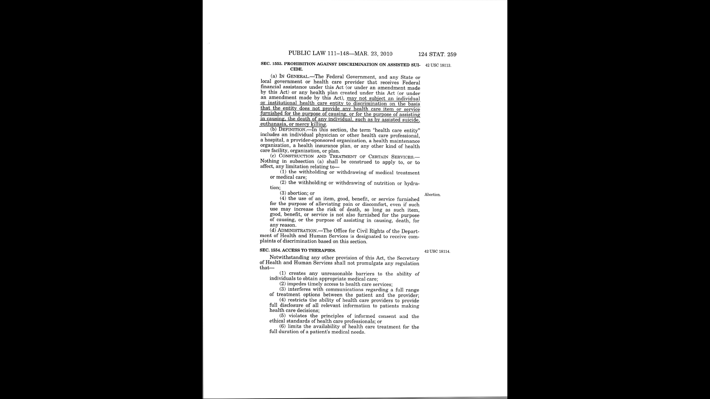

Slide 18
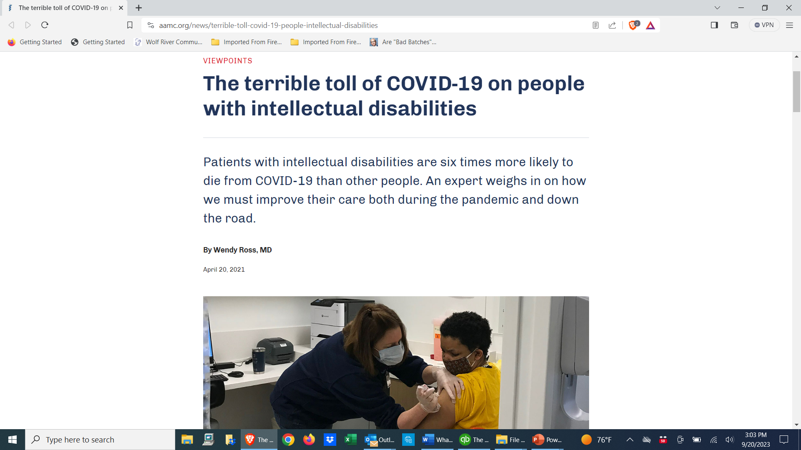
COVID exposed the reality of medical murder – the disabled

Slide 19
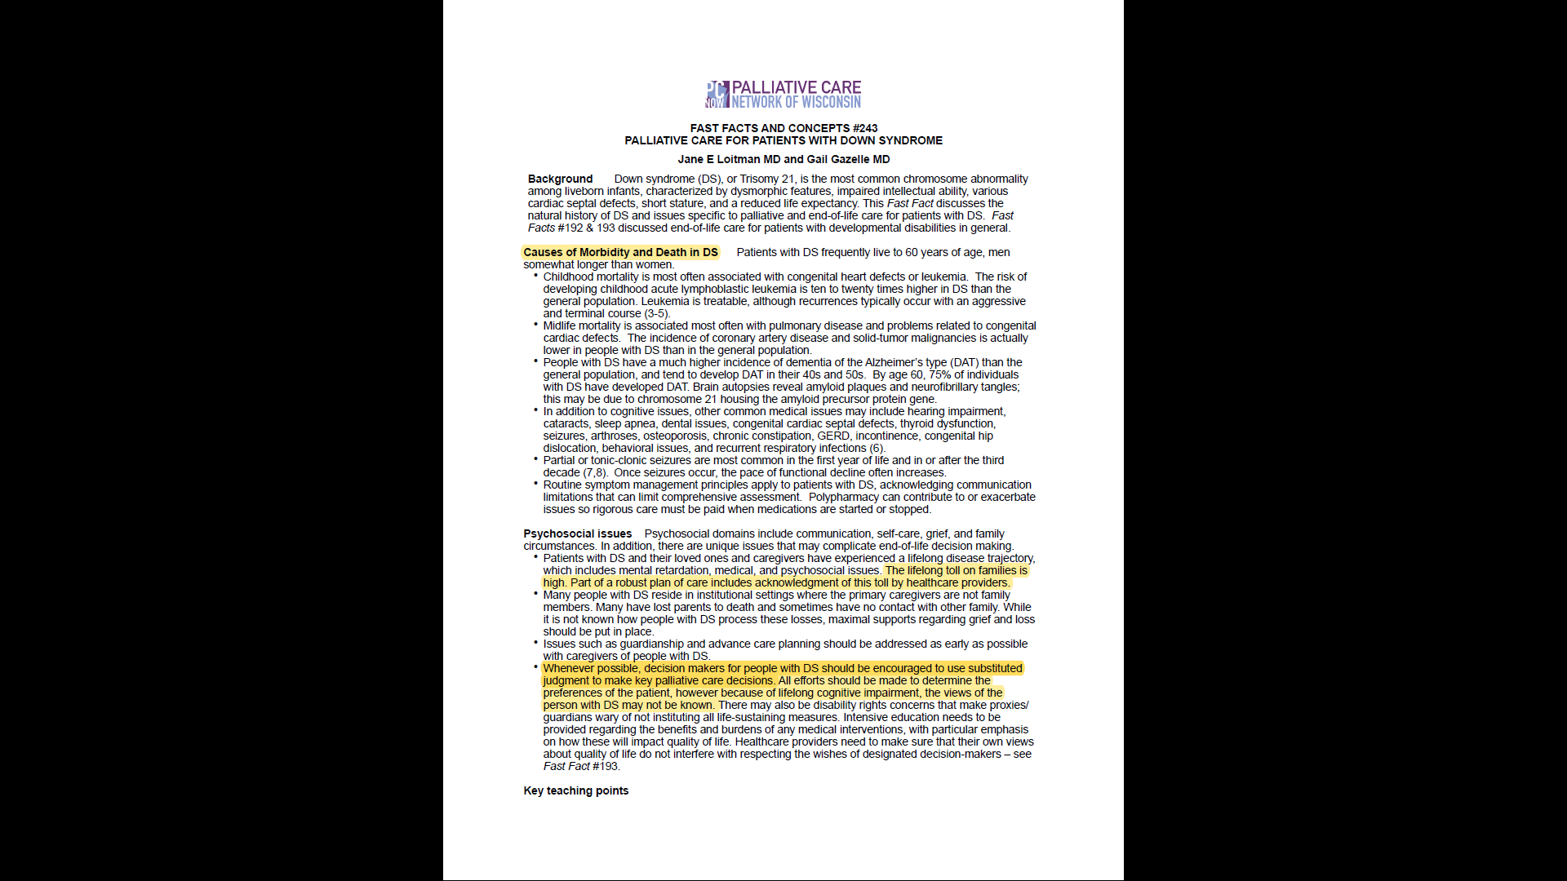

Slide 20
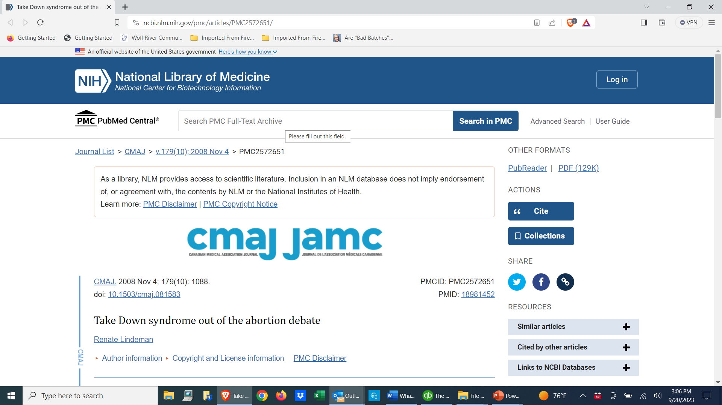
Palin said she was “devastated and shocked” to receive a prenatal diagnosis of Down syndrome. With abortion rates hovering around 90% after Down syndrome is diagnosed, she isn't the only one who has feared the unknown.

Slide 21
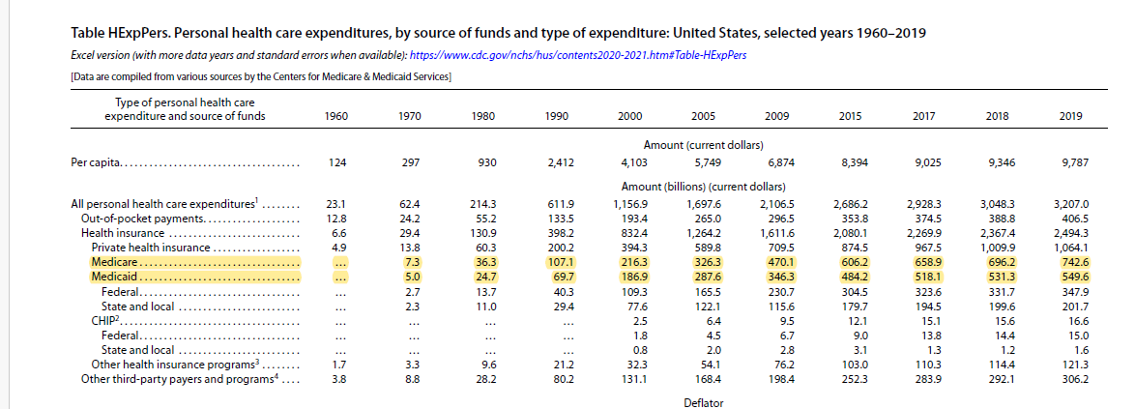
Elderly Financial Statistics: 105X increase in Medicare/Medicaid costs in 49 years – over 10,000%!

Slide 22
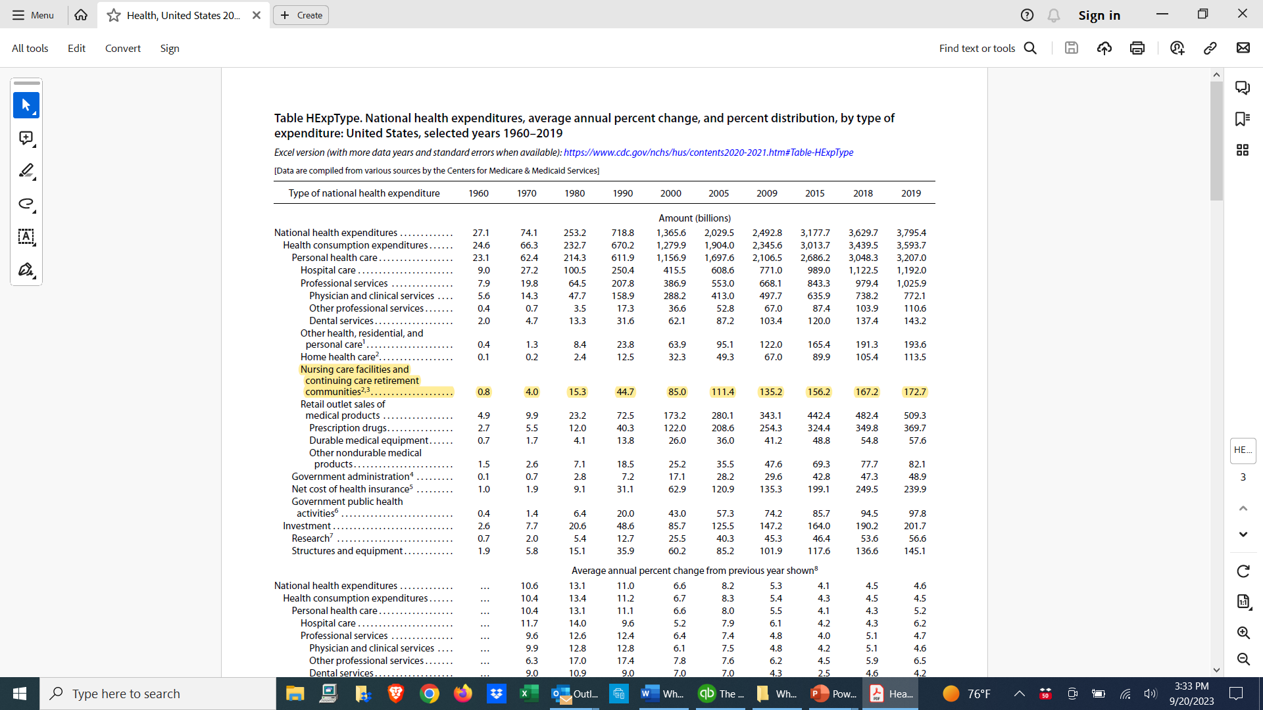
Elderly Financial Statistics: 216X increase in nursing care facility costs in 59 years – over 20,000%!

Slide 23
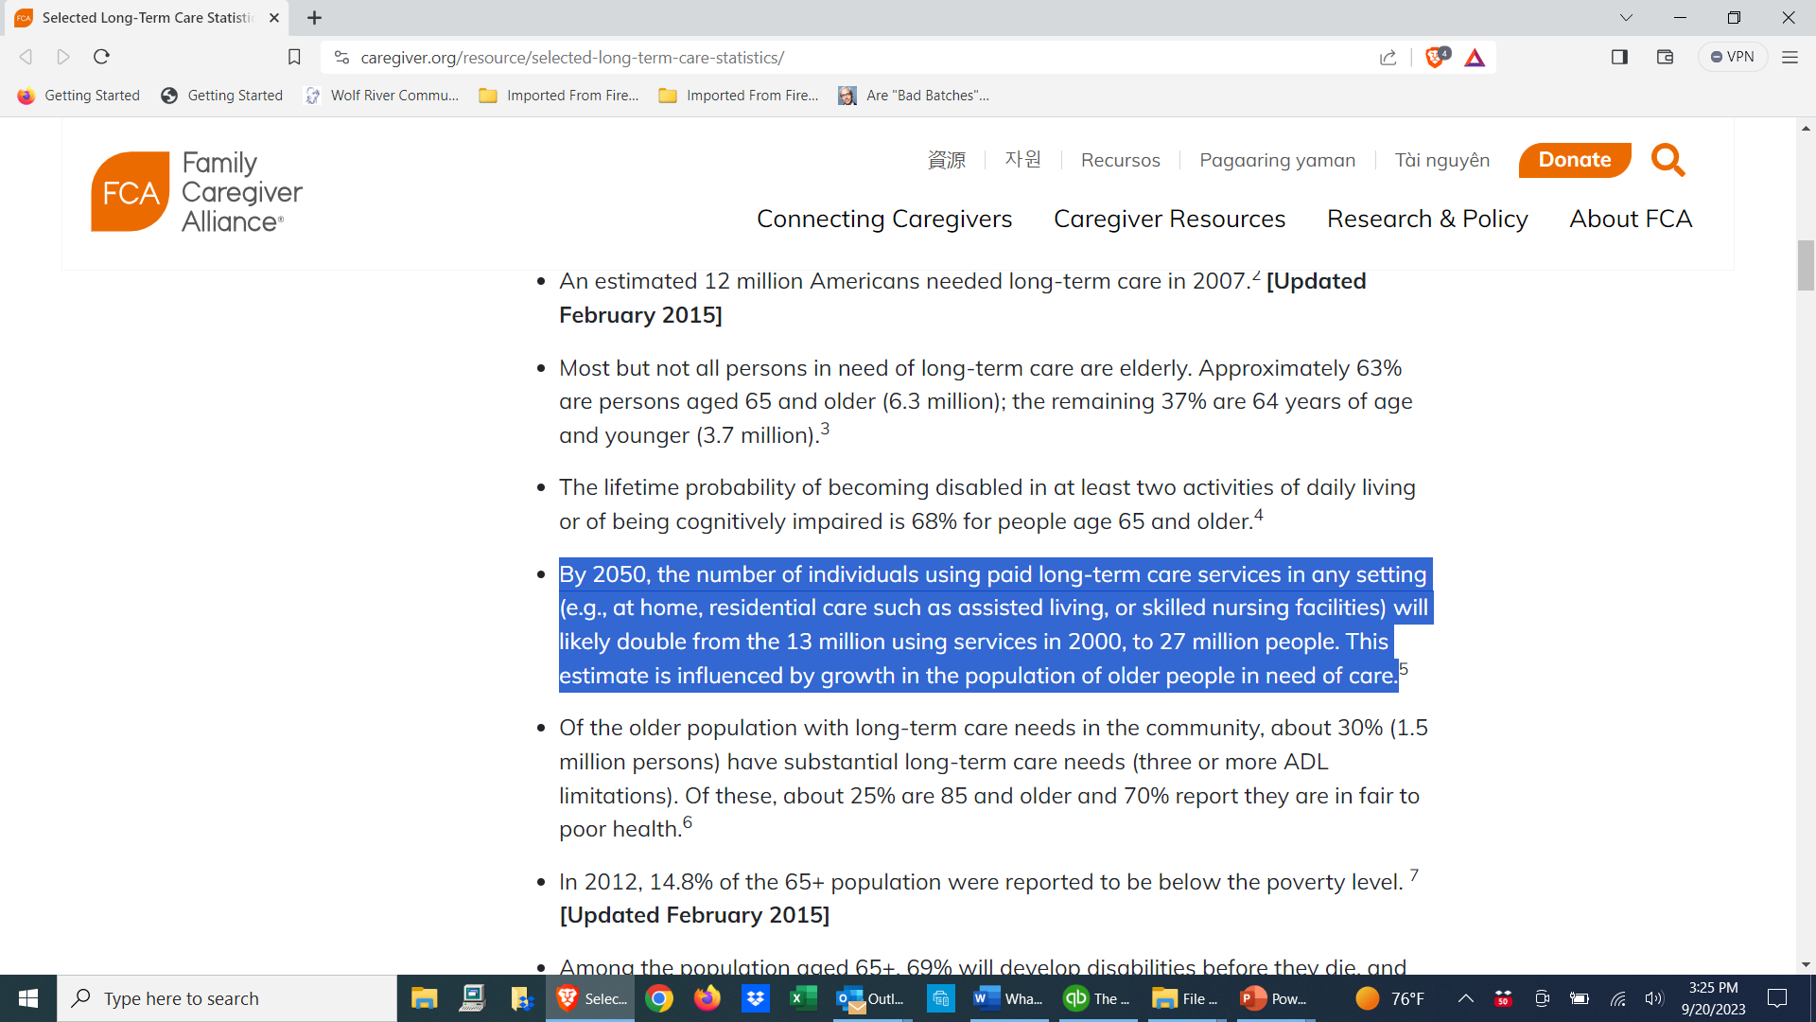

Slide 24
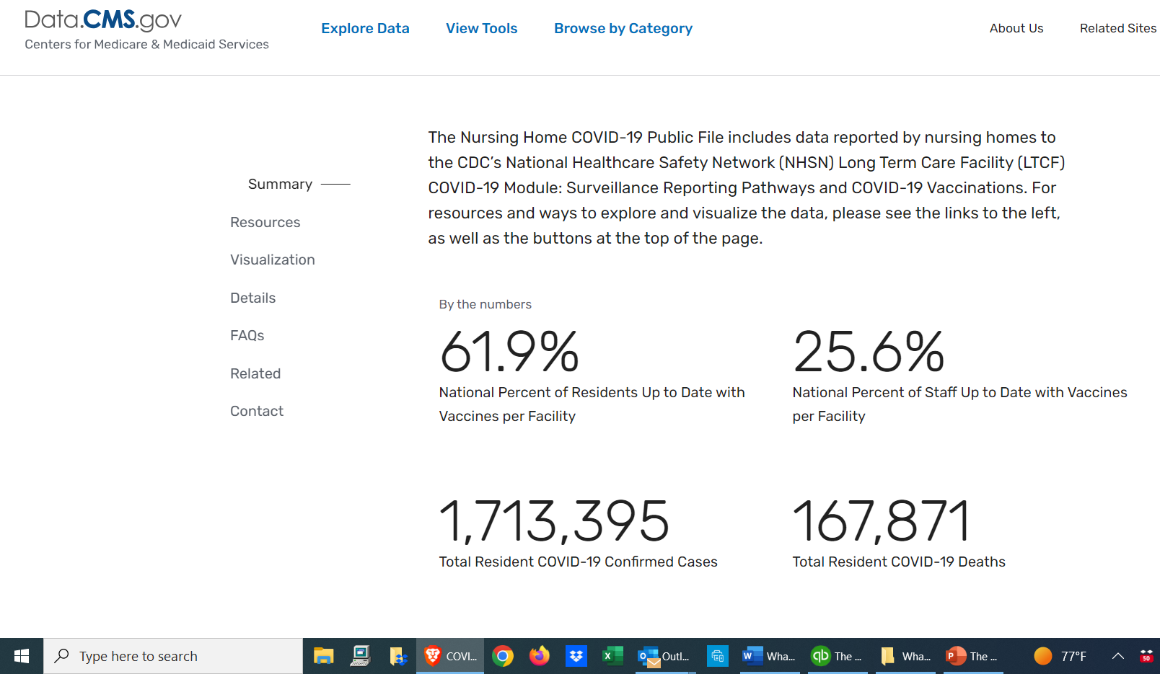
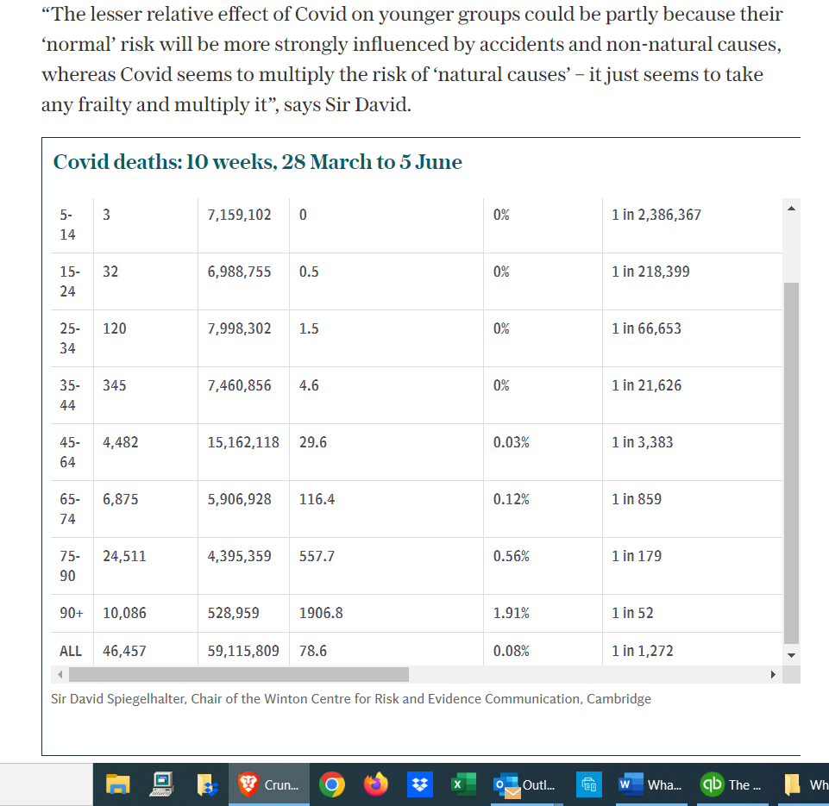
COVID death numbers in nursing homes make no sense – 10% vs. 1% reality https://rumble.com/v1dzhh9-mel-k-with-scott-schara-and-vera-sharav-on-medical-tyranny-then-and-now.html https://rumble.com/v1do9gx-july-22-2022-scott-schara-and-vera-sharav.html

Slide 25
Conclusion: The disabled and the elderly are the low hanging fruit of the eugenics mindset the culture has adopted. Hastening death is murder.
History never stopped repeating itself:
https://ouramazinggrace.net/Videos/News/Genocide%20Then%20and%20Now.mp4

Slide 26

Eugenics doesn’t just apply to the disabled and the elderly

Slide 27

A convergence of attacks on the entire population
Medical murder (the lane I’m in) is only one tentacle of the depopulation agenda – wars, famine, food shortages, China threats, climate manipulation, poisoning (food and water), controlling the power grid, buying and selling with fake money, 5G, phone radiation, fluoride in water, mercury fillings, organ harvesting, child sacrifice, child trafficking, open borders, trans movement; CBDC – a convergence that is all part of the ultimate control grid!

Slide 28
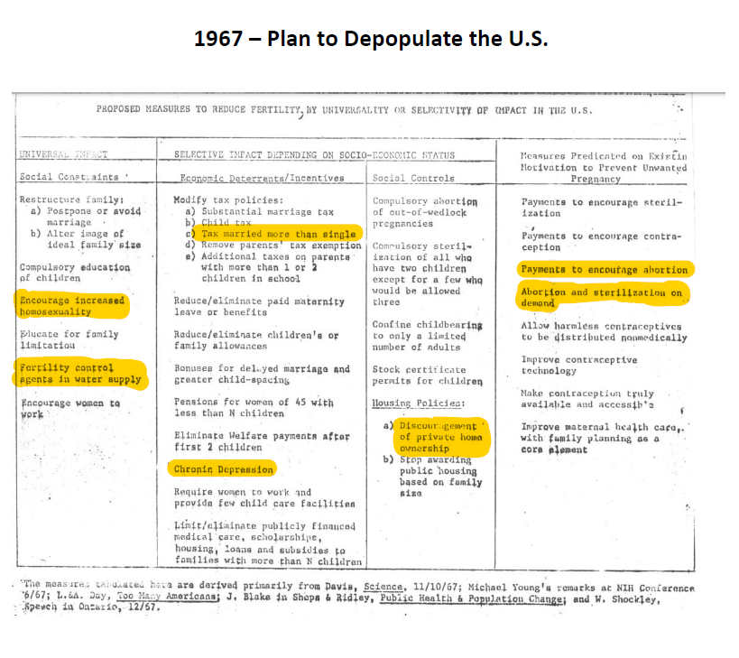
Plans to depopulation the U.S. were formalized in 1967 - Berelson and Jaffe would work together on the 1972 Rockefeller Commission Report

Slide 29
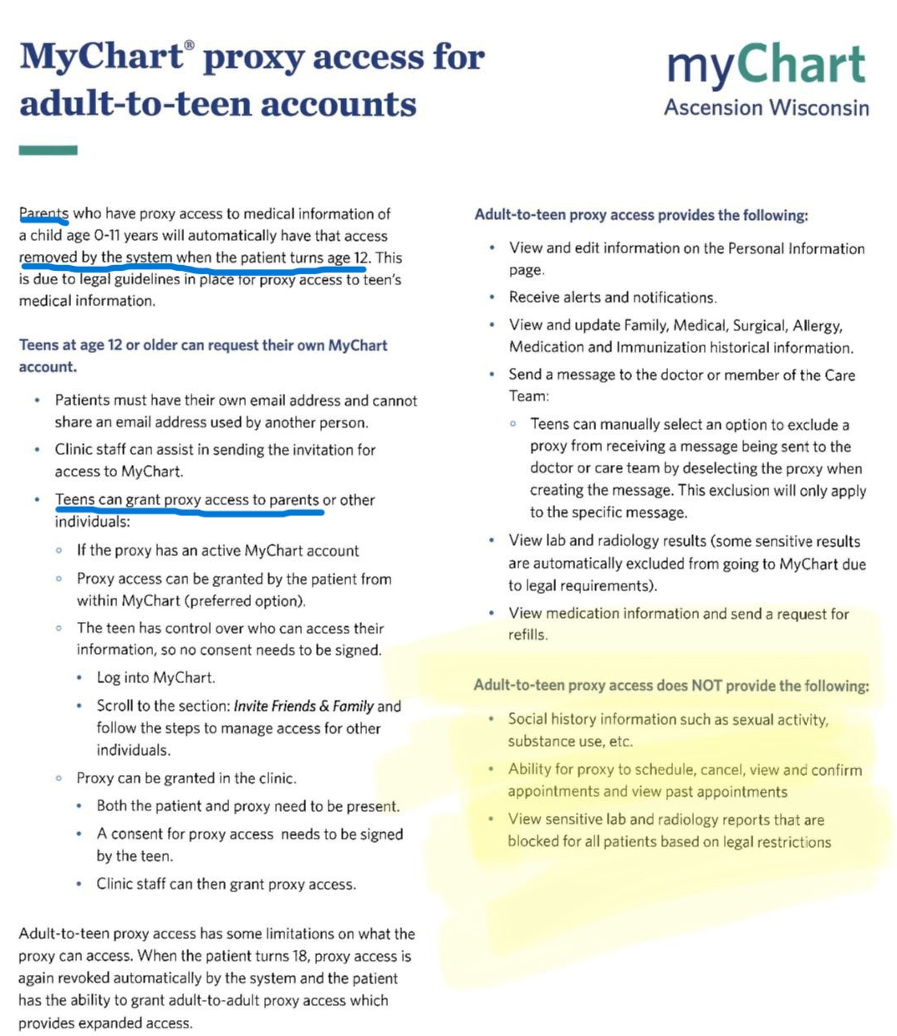
Let’s get the kids in on it

Slide 30
Conclusion: You’re next!

Slide 31
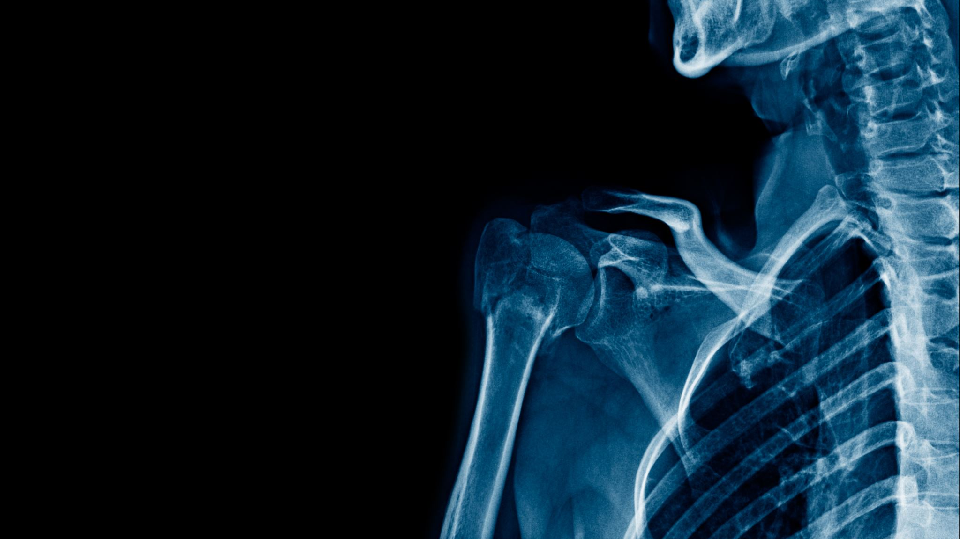
No consequences for murder

Slide 32
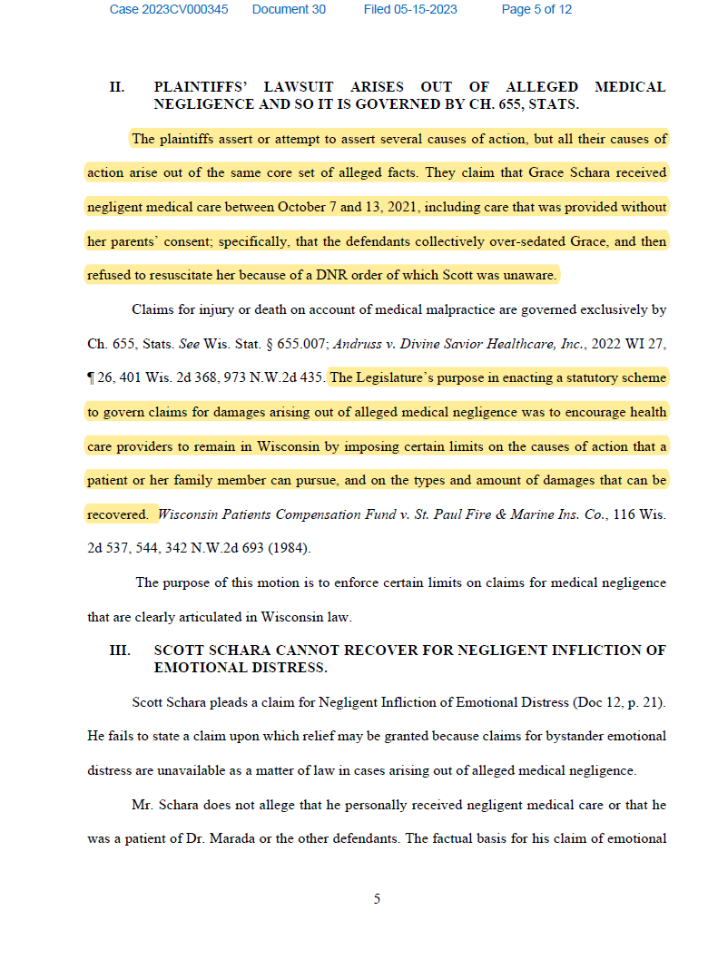
An Example…
Think about this statement of motive – ‘we need to limit liability for doctors, or they won’t come to our State’ is the basis for a law which ends up targeting the citizens impacted by medical malfeasance. Do good doctors need liability protection? This game has been implemented by the “health care” lobby to facilitate the culture of death.

Slide 33

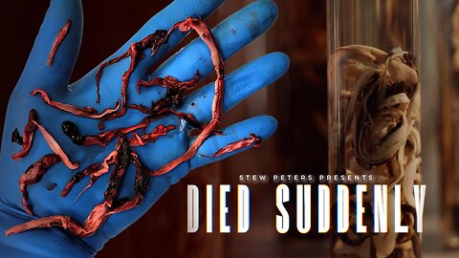
Even worse…
How has The National Childhood Vaccine Injury Act of 1986, eliminating liability for vaccine manufacturers, worked out? Ask someone with autism if you are wondering.
How about someone who died suddenly of the newly invented Sudden Adult Death Syndrome, as the result of taking the “vaccine” that was going to be our savior?

Slide 34
Conclusion: God’s economy has consequences for choices. When the consequences are removed, by law, the effects are catastrophic.

Slide 35
Medical Murder is the #1 Cause of Death in the U.S. – By Design (People Are Too Expensive – Satan’s Big Lie) Up Next…
Where? Mystery Babylon

